Slide 1
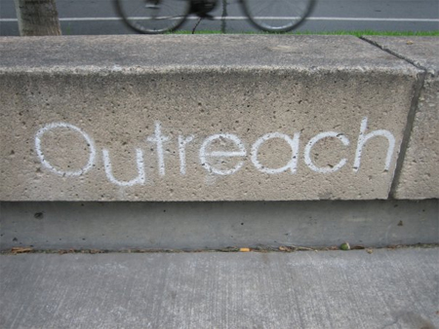
Community Outreach Project: Our Daily Bread Canned Food Drive
http://ourdailybread.us/programs/kids-club/our-family-table/
Christian Lipa
www.socialmediaexaminer.com
www.blogut.ca

Slide 2
What Inspired Me The Most
Visit to Northside:
–Wordplay
-Elissa speaking about kids being “lost in the crowd”
-Wanting to help people who are “lost in the crowd” during the holidays.
Visits to OTR:
-Exploring OTR
-Encouragement from Jessica and my classmates
-Discovering my own image of OTR
-Wanting others to discover the changes in OTR

Slide 3
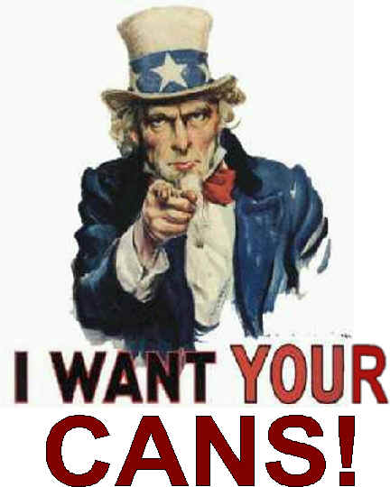
Why I Chose Our Daily Bread and a Canned Food Drive
Our Daily Bread is a:
-Ministry of hospitality
-Located in OTR
-Dedicated to serving neighborhood
residents and individuals who frequently
visit the area.
-Assists people by providing warm meals, social services,
and places for guests to socialize in a safe, respectful
environment.
I chose this organization because it gives back to
people, mainly those who are homeless or going
through difficult financial times, who are often "lost in the
crowd" during the holidays.
www.bgcn.org

Slide 4
Organization
I decided I would spend two days collecting cans in Amberley and Delhi
Passed out flyers I created describing what people needed to know in order to take part in my canned food drive
-One flyer for Delhi and another for Amberley
Passed out a flyer about OTR and 3CDC

Slide 5
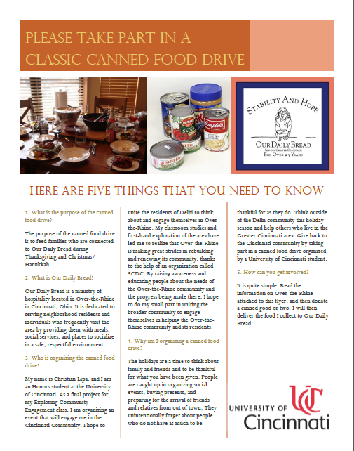
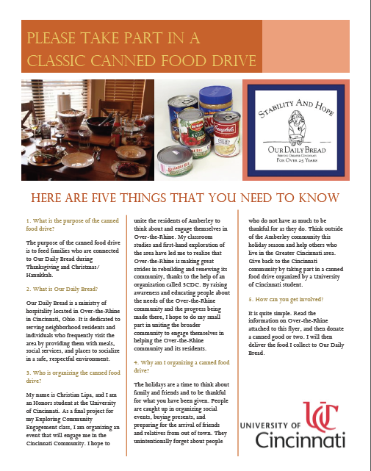
Classic Canned Food Drive Flyers

Slide 6
What the Classic Canned Food Drive Flyers Describe
Purpose of the canned food drive
Our Daily Bread Information
Who is organizing the canned food drive
Why I am organizing a canned food drive
How people can get involved

Slide 7
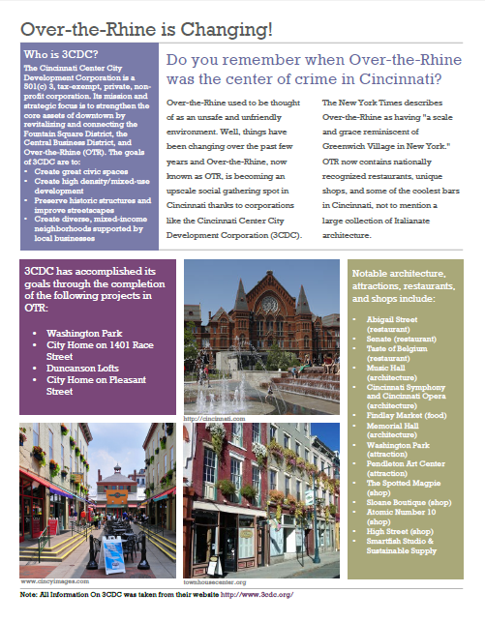
OTR and 3CDC Flyer

Slide 8
Why Delhi and Amberley
Easy accessibility
I grew up in Amberley
My grandparents live in Delhi and I often visited them as a child
Amberley’s community is very “close-minded”
Both areas contain people from different classes
-Amberley is an “upper class” area
-Delhi is a “middle class” area
People know my family in Amberley and my grandparents in Delhi
Influence from both areas led me to form negative views of Over the Rhine

Slide 9
Carrying Out the Canned Food Drive
Went from house to house presenting information and asking people if they had canned goods
November 24:
-From 12:00 to 3:00 in Delhi
-Most people gave 2 canned goods and read OTR and 3CDC information
-Kind words as I departed
-Over 40 canned goods
November 25:
-From 12:00 to 2:30 in Amberley
-Most people gave more than two canned goods and neglected information
-Interaction with Mrs. Frank
-Over 50 canned goods

Slide 10
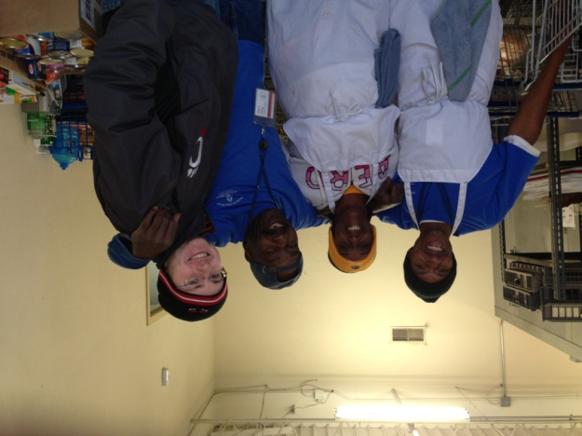
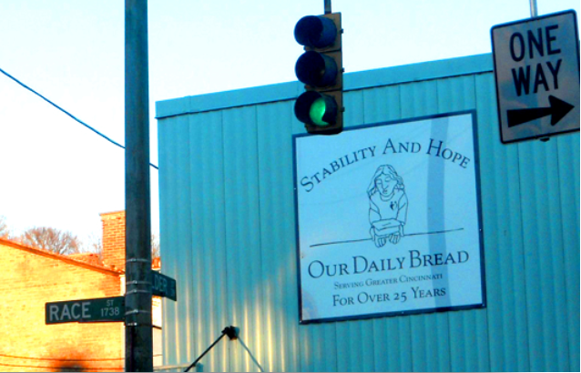
Dropping Off The Canned Goods At Our Daily Bread
On November 26 my mom drove me to Our Daily Bread in OTR
Workers helped me unload the canned goods and educated me about Our Daily Bread
Felt a sense of accomplishment
http://ourdailybread.us/

Slide 11
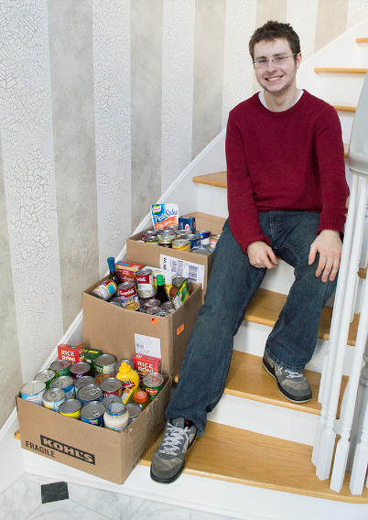
Result of My Community Outreach Project
Collected over 120 canned goods
Reminded people to think outside their own communities and assist others in Greater Cincinnati area.
Learned to engage and communicate with people who live outside of OTR to think about and engage themselves in OTR.
I have done my small part in uniting the
broader community to engage themselves in
helping the OTR community and its residents.
Have become an active citizen who is both
well-informed and engages in two areas in
Cincinnati.

Slide 12
What I Took Away From Exploring Community Engagement
How seeing the world from one point of view is no way to live
How to define a true active citizen
Walnut Hills meet-up
-Talking to an African American man and his opinions on community, community engagement, and service.
As a busy college student, my time to engage in the Cincinnati Community is limited. I should spend the limited time I have focusing on helping a few people/organization that actually need and want my help.

